Slide 1
Credit EDA Case Study
By Sumit Bhatia

Slide 2
Problem Statement.
This case study aims to identify patterns which indicate if a client has difficulty paying their installments .
This may be used for taking actions such as denying the loan, reducing the amount of loan, lending (to risky applicants) at a higher interest rate, etc.
This will ensure that the consumers capable of repaying the loan are not rejected.
Identification of such applicants using EDA is the aim of this case study.

Slide 3
Assumptions
Rows containing XAN and XAP values were dropped if they were in small numbers.
If rows containing XAN and XAP values were high in number then these values were assumed as null values.
They were not taken into consideration while deriving insights from the data.

Slide 4
Missing value and outlier treatment
Application Dataset
Columns containing more than 40% of missing values were dropped.
Remaining missing values in continuous columns were imputed by their median.
Remaining missing values in categorical columns were imputed by their mode.
Outliers, if present in continuous columns were capped by applying upper bound and lower bound with the help of IQR.
Previous Dataset
Columns containing more than 45% of missing values were dropped.
Remaining missing values in continuous columns were imputed by their median.
Remaining missing values in categorical columns were imputed by their mode.
Outliers, if present in continuous columns were capped by applying upper bound and lower bound with the help of IQR.

Slide 5
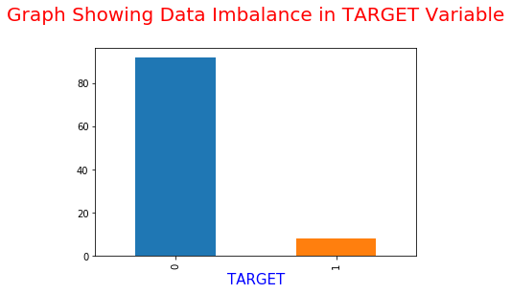
Data Imbalance
As we can see in our data set only app. 8% clients face difficulties in loan repayment, which is quite practical also. Imbalance can be clearly seen in our "TARGET" column. So we will divide our application data set into two.
1. Clients with payment difficulties
2. Clients with no payment difficulties.
Also in "TARGET" column we will replace "1" with "defaulter" and "0" with "non-defaulter".

Slide 6
Univariate Analysis on Categorical Columns In Segmented Application Dataset

Slide 7
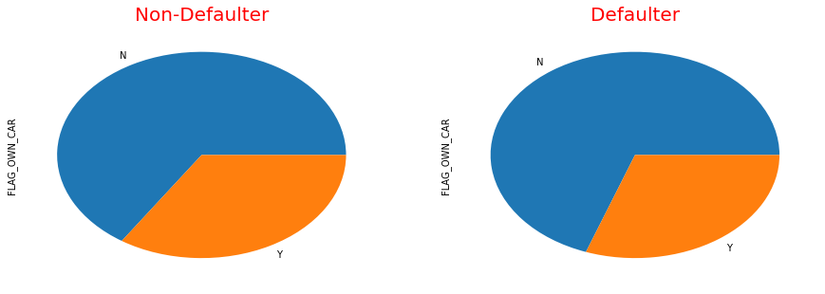
Clients with own car wrt TARGET
Insights from the graph :
1. More number of people defaulting the loan do not own a car.
2. People who do not own a car are giving higher number of loan applications.

Slide 8
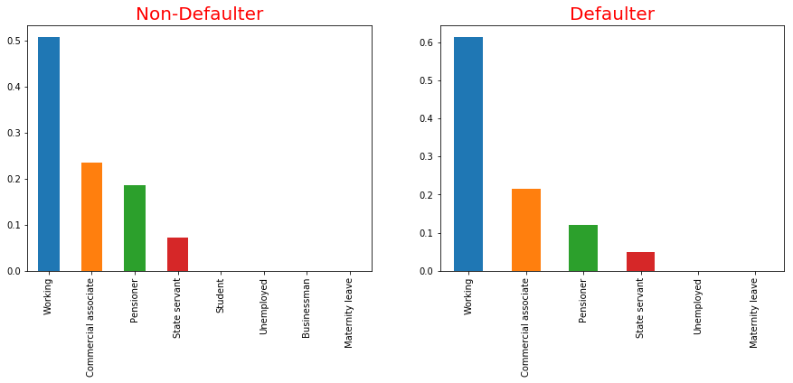
Clients Income Type wrt TARGET
Insights from the graph :
1. Pensioners are less likely to default as compared to other income types.
2. Working people are more likely to default. At the same time, working people are giving maximum business to the bank.

Slide 9
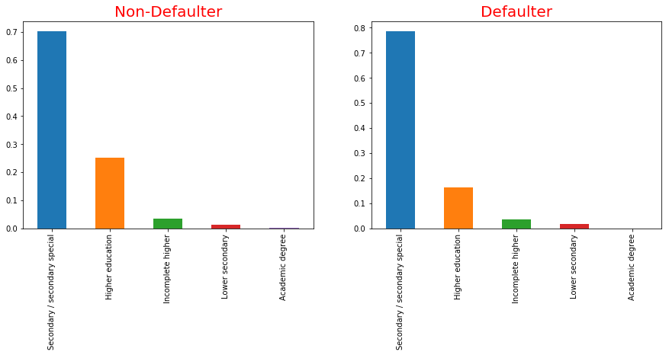
Client’s Education wrt TARGET
Insights from the graph :
1. People with Secondary/Secondary special education are the ones with highest number of loan applications.
2. People in Higher Education category are less likely to default as compared to other categories.

Slide 10
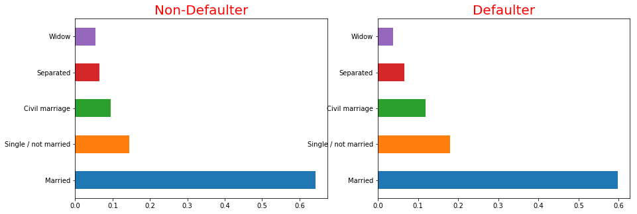
Client’s Family Status wrt TARGET
Insights from the graph :
1. Married people are applying for the loans in higher number..
2. Single/Not Married and Civil Marriage people have slightly higher chances of default.

Slide 11
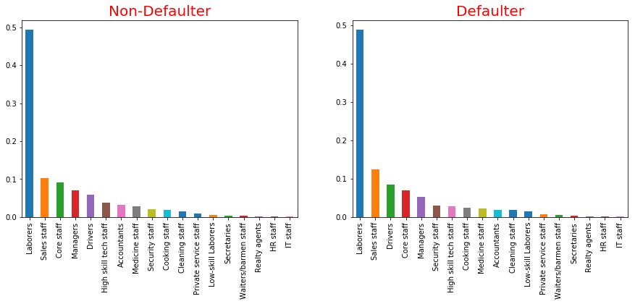
Occupation Type wrt TARGET
Insights from the graph :
1. People working in the Laborers category have highest number of loan applications in both cases.
2. Managers have a low chances of loan default.
3. Sales Staff and drivers have a higher
chances of loan default.

Slide 12
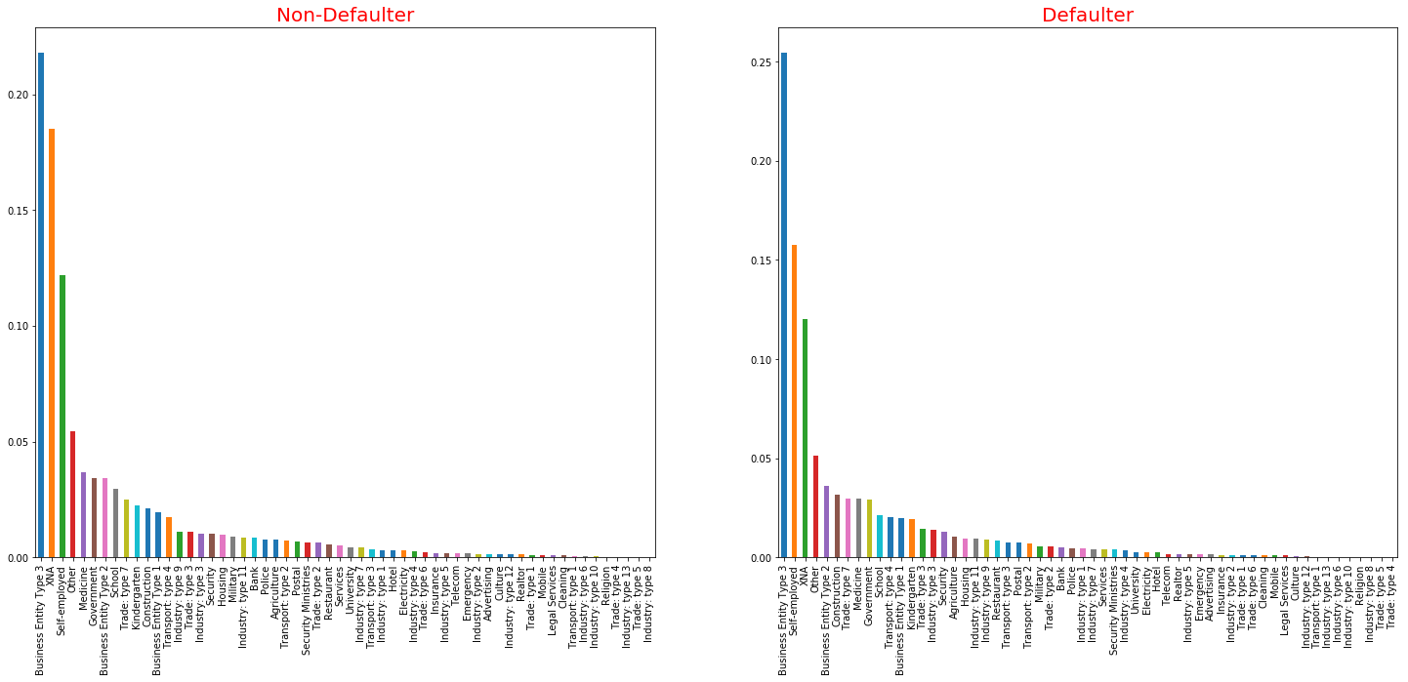
Organization type wrt TARGET
Insights from the graph :
Clients with organization type as Business Entity Type 3 and Self Employed are more likely to default.

Slide 13
Univariate Analysis on Continuous Columns In Segmented Application Dataset

Slide 14
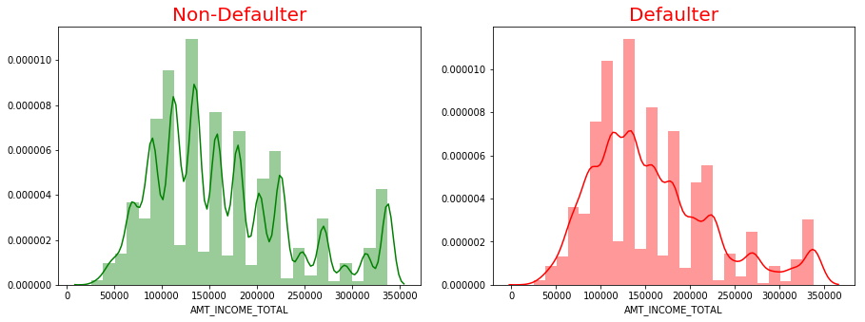
Income v/s Target
Insights from the graph :
People with higher Income Total are less likely to default.

Slide 15
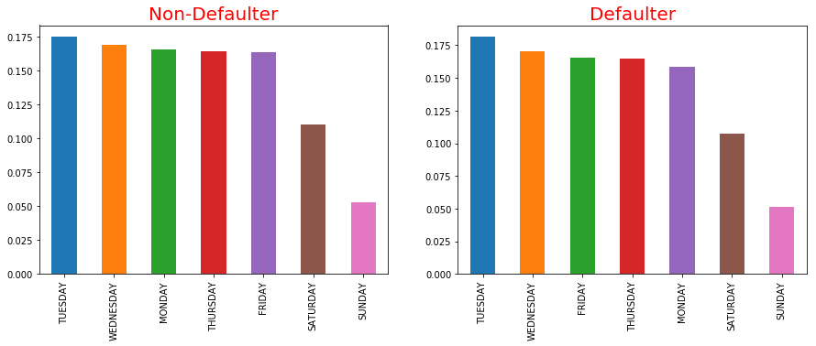
Weekday Process Start wrt TARGET
Insights from the graph :
Bank receives more loan applications on weekdays as compared to weekends(Saturday and Sunday).

Slide 16
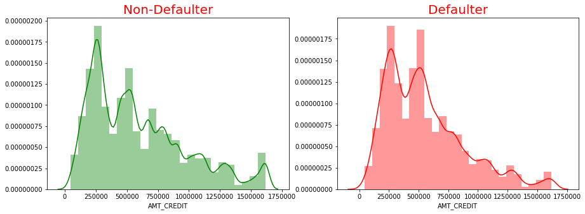
Amount Credit v/s Target
Insights from the graph :
People with higher Credit amount of loan are less likely to default.

Slide 17
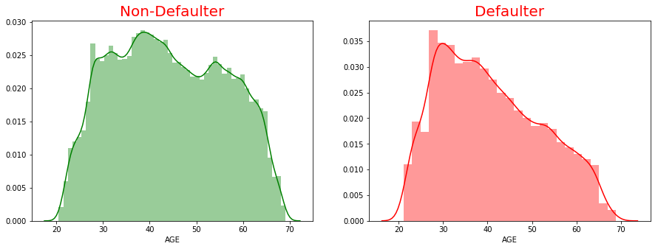
Age v/s Target
Insights from the graph :
1. People aged between 25 and 45 are the ones with high number of loan applications.
2. People above 50 years of age are less likely to default on their loan.

Slide 18
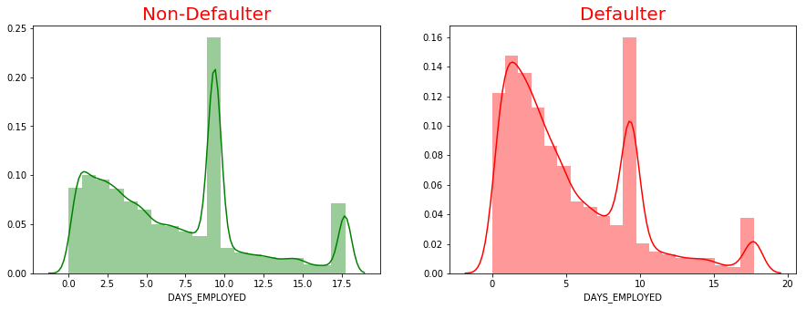
Days_Employed v/s Target
Insights from the graph :
1. People who newly got employed into their current employment(less than 4 years) are the highest among loan defaulters.
2. People working for a long time into their current employment(more than 10 years) are less likely to default.

Slide 19
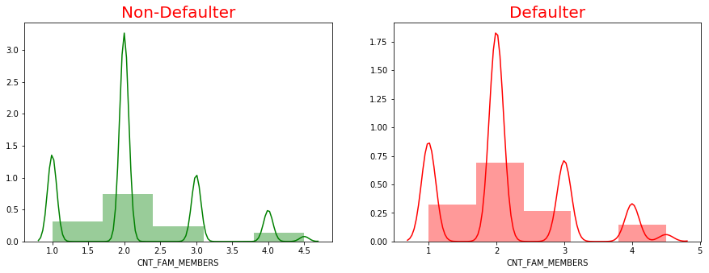
CNT_FAM_MEMBERS v/s TARGET
Insights from the graph :
People from smaller families have more number of loan applications.

Slide 20
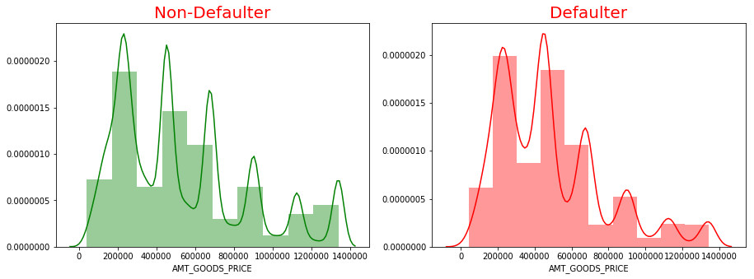
AMT_GOODS_PRICE V/S TARGET
Insights from the graph :
Higher the price of goods , lesser is the chance of default.

Slide 21
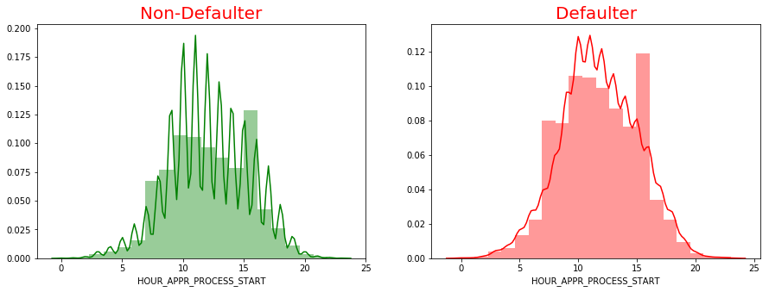
HOUR_APPR_PROCESS_START V/S TARGET
Insights from the graph :
Bank received highest number of loan applications between 10 o'clock in the morning to 2 o'clock in the afternoon.¶

Slide 22
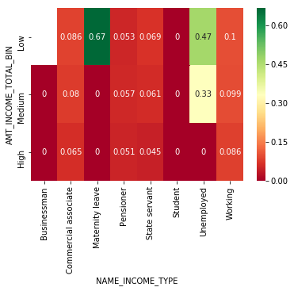
Correlation Graph
Insights from the graphs :
1. Clients with income type as maternity leave and having low income are more likely to default.
2. Clients who are unemployed are more likely to default.¶

Slide 23
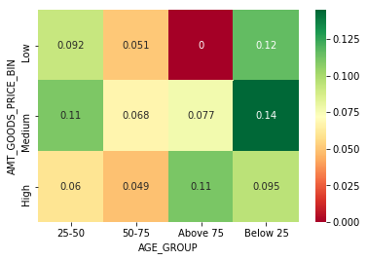
Correlation Graph
Insights from the above graphs :
Clients below 25 years of age with medium Goods Price are more likely to default.

Slide 24
Analysis of categorical columns in previous data set

Slide 25
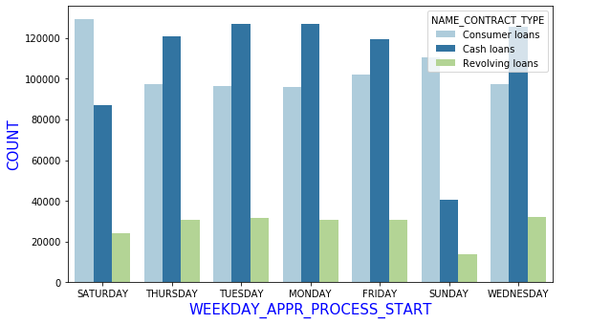
Count Plot Weekday_appr_process_start v.s name_contract_type
Insights from the graph:
Bank received relatively higher consumer loan applications on Saturdays and Sundays.

Slide 26
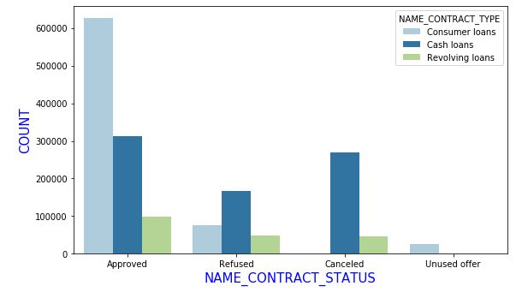
Count plot name_contract_status v.s name_contract_type
Insights from the graph :
Consumer loans are highest to be approved followed by cash loans and revolving loans.

Slide 27
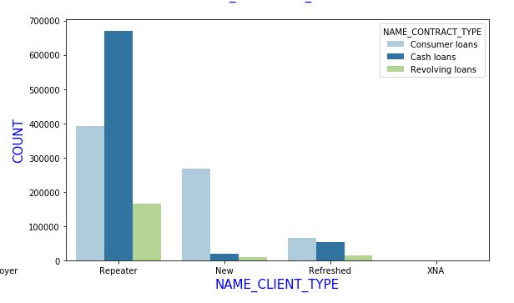
Count plot on name_client_type v.s name_contract_type
Insights from the graph :
Repeater Clients are applying for cash loans in comparatively higher number. New clients are opting for consumer loans in higher number.

Slide 28
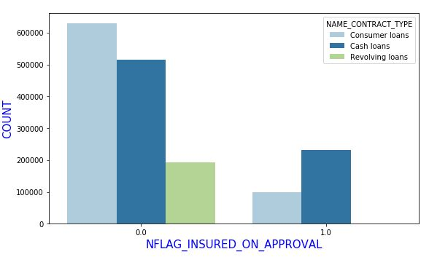
Count plot insured_on_approval v.s name_contract_type
Insights From The Graph :
Majority of clients do not prefer to apply for the insurance.

Slide 29
Analysis of continuous columns in previous data set

Slide 30
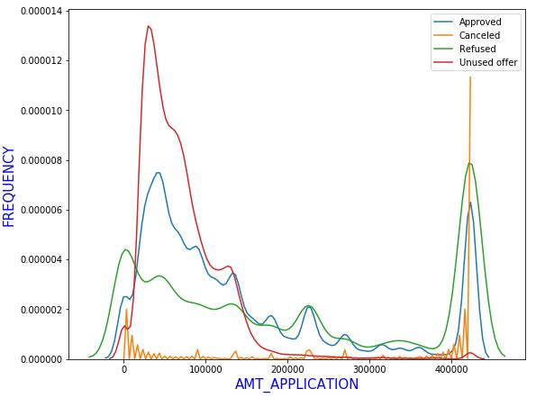
Distplot amt_application v.s loan status
Insights From The Graph :
With high application amount comes high chances of refusal.

Slide 31
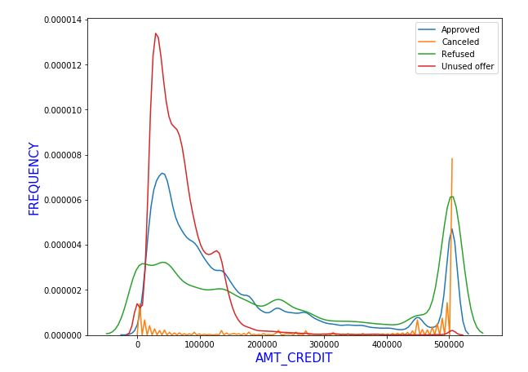
Distplot amt_credit v.s loan status
Insights From The Graph :
AMT_CREDIT below 10000 has the highest chances of approval.

Slide 32
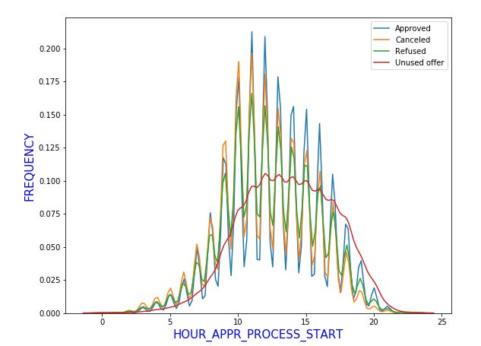
Distplot hour_appr_process_start v.s loan status
Insights From The Graph :
Bank receives highest number of loan applications between 10 A.M to 2 P.M.

Slide 33
Analysis of categorical columns in merged data set

Slide 34
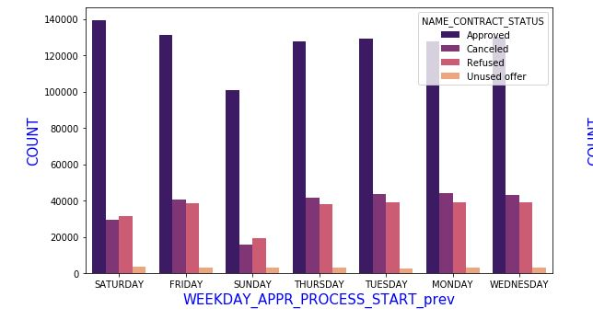
Count plot week_appr_process_start v.s loan status
Insights From The Graph :
Chances of refusal and cancellations are less on Saturdays.

Slide 35
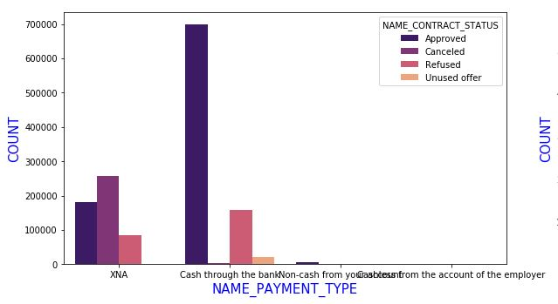
Count plot name_payment_type v.s loan status
Insights From The Graph :
Payment type Cash through bank has a high chance of approval.

Slide 36
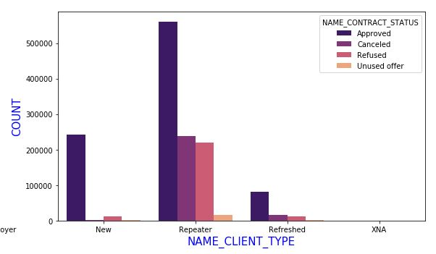
Count plot name_client_type v.s loan status
Insights From The Graph :
Repeater clients have a very high chance of approval.

Slide 37
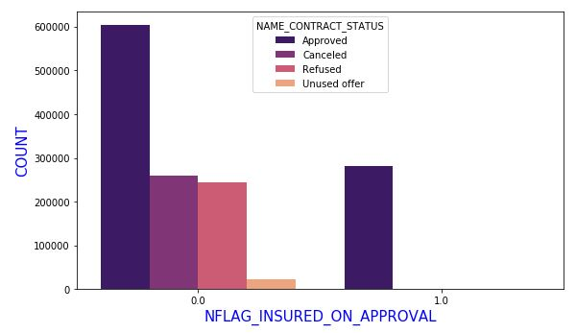
Count plot insured_on_approval v.s loan status
Insights From The Graph :
Clients who have applied for insurance have very low chances of refusal.

Slide 38
Analysis of continuous columns in merged data set

Slide 39
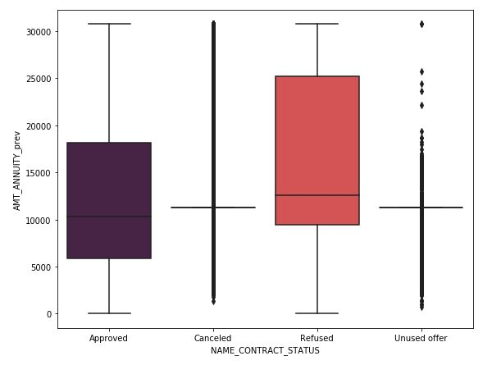
Box plot loan status v.s amt_annnuity
Insights from the above graphs :
> Lower AMT_ANNUITY has higher chances of approval.

Slide 40
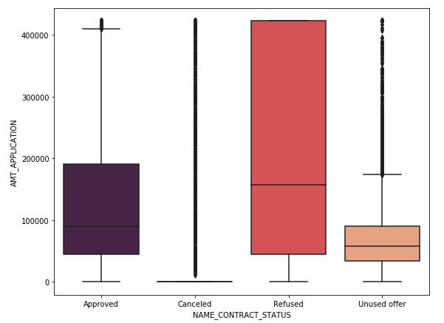
Box plot loan status v.s amt_application
Insights from the graph :
> Lower AMT_APPLICATION has higher chances of approval and higher

Slide 41
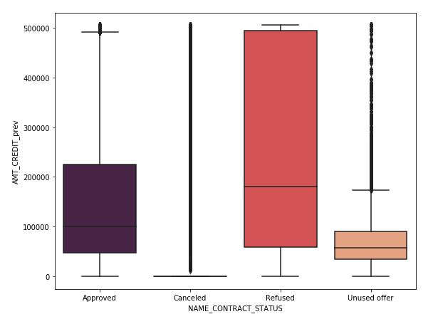
Box plot loan status v.s amt_credit
Insights From The Graph :
> Higher AMT_CREDIT has higher chances of refusal.

Slide 42
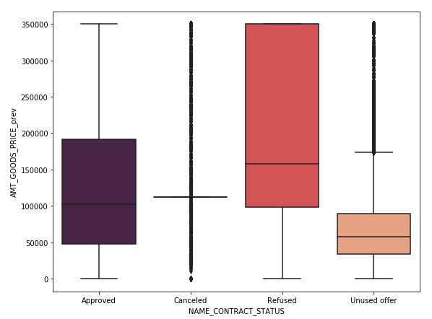
Box plot loan status v.s amt_goods_price
Insights From The Graph :
> Higher AMT_GOODS_PRICE has lower chances of approval.

Slide 43
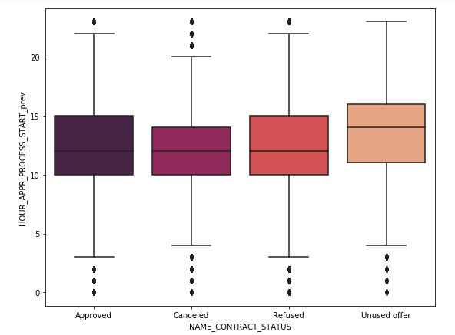
Box plot loan status v.s hour_appr_process_start
Insights From The Graph :
> Higher applications are approved between 10 AM to 2 PM.

Slide 44
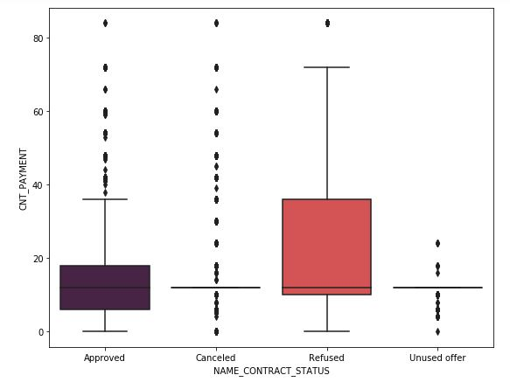
Box plot loan status v.s cnt_payment
Insights From The Graph :
> Lower loan tenures have lower chances of refusal.

Slide 45
Conclusion
Clients who do not own a car are tend to default on loan.
Pensioners are less likely to default and working people are more likely to default.
Clients with higher education are less likely to default.
Single/Not Married and Civil Marriage people have slightly higher chances of default.
Managers have a low chances of loan default.
Clients with organization type as Business Entity Type 3 and Self Employed are more likely to default.
People with higher Income Total are less likely to default.
People with higher Credit amount of loan are less likely to default.
People above 50 years of age are less likely to default on their loan.
People who newly got employed into their current employment(less than 4 years) are the highest among loan defaulters.
Repeater Clients are applying for cash loans in comparatively higher number. New clients are opting for consumer loans in higher number.

Slide 46
Thank you

